Slide 1
Design a Spaceship Game Starter
By:Jaxon Driver

Slide 2

Background of Game

Slide 3
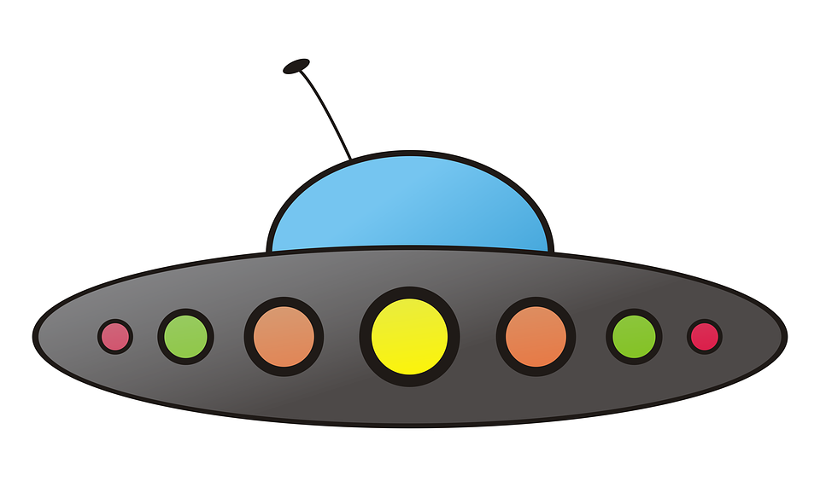
Enemies

Slide 4

User’s Spaceship

Slide 5

Laser

Slide 6

Asteroids

Slide 7
Main Idea
I want my Spaceship Game to be a classic space shooter where you shoot asteroids and enemy alien ships. The slides above are a brief representation of what I want to do, the main idea of what I want but not exactly what I want. I did this in slides to show individually what I want for each thing rather than drawing it on a piece of paper.

